Slide 1
EDA on Facebook Data
Shashank Singh
Sep 2020

Slide 2
Problem Statement
Facebook has become quite popular in the recent few years with people all over the world using it as a medium to share their status, thoughts and pictures with their friends.
With the mobile app , it has become even more popular and easier to access. People from all age groups are connected to Facebook, however there are certain differences in their way of using it such as with respect to initiating friendships and sending likes .
We are trying to study the dataset provided to identify certain patterns with respect to how the users are making use of this most popular social networking app depending on their age group, gender etc.

Slide 3
Approach
We are considering 3 main user categories to identify pattern of users –
Gender,
Age Group
Tenure
We will consider four major activities for which data is available –
Friend Count
Friendships Initiated
Likes Given
Likes Received
We will analyze two medium of activity for above categories and activities –
Mobile App
Website

Slide 4
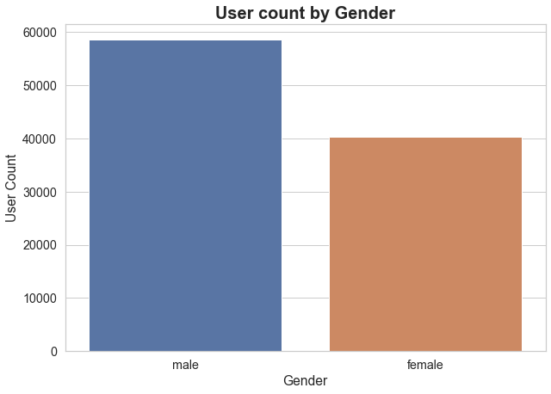
Data Visualization – User Count

Slide 5
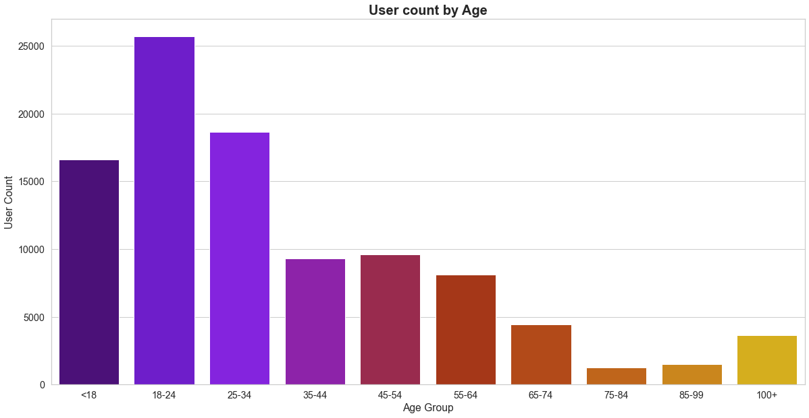
Data Visualization – User Count

Slide 6
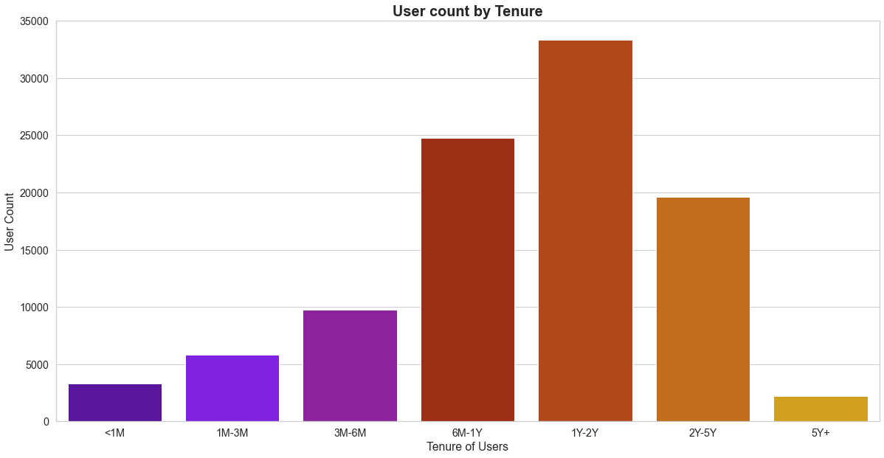
Data Visualization – User Count

Slide 7
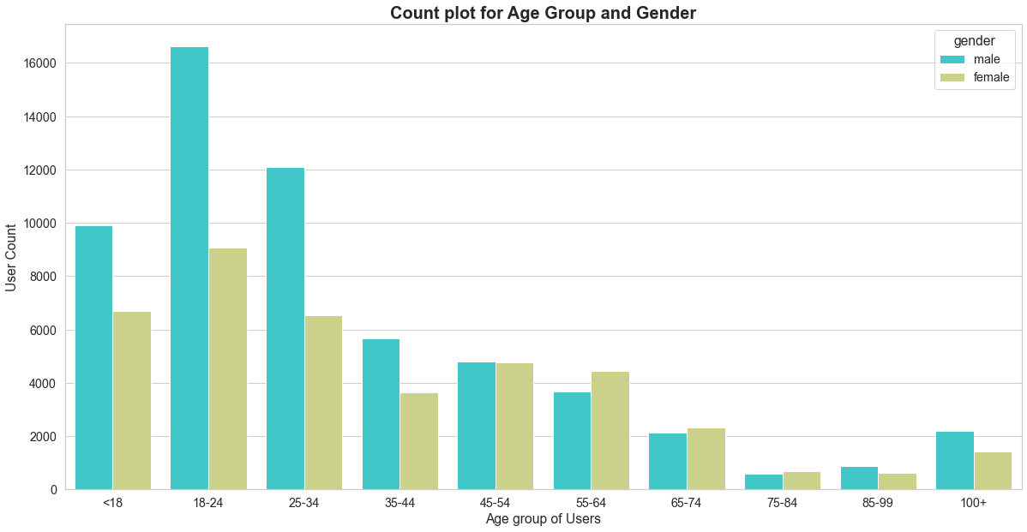
Data Visualization – User Count

Slide 8
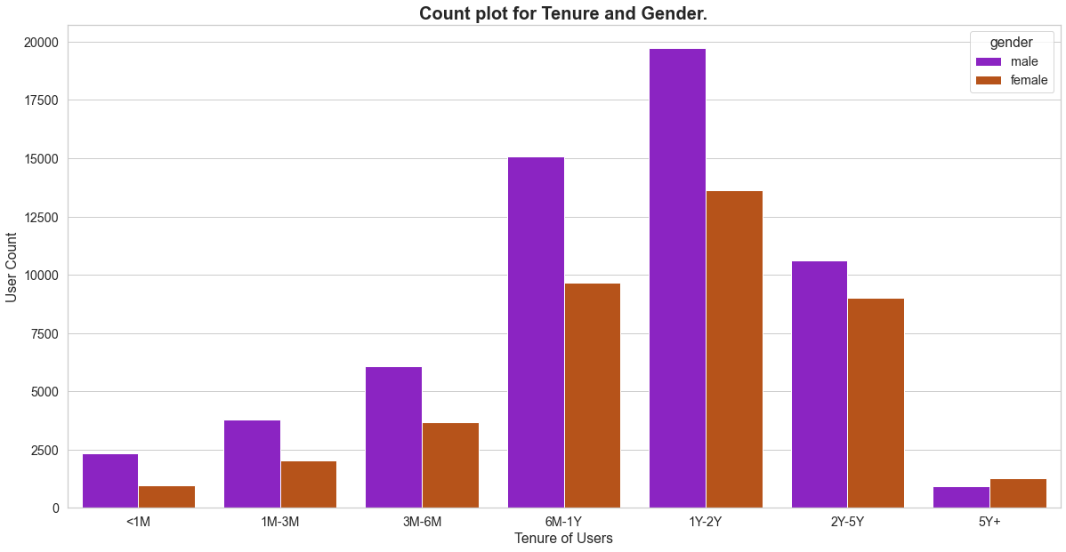
Data Visualization – User Count

Slide 9
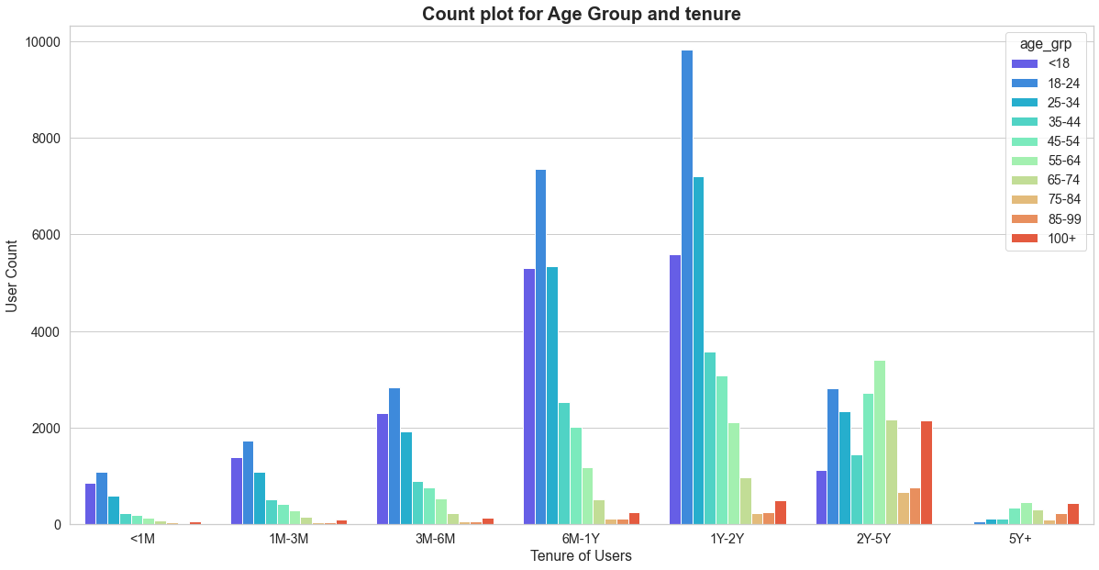
Data Visualization – User Count

Slide 10
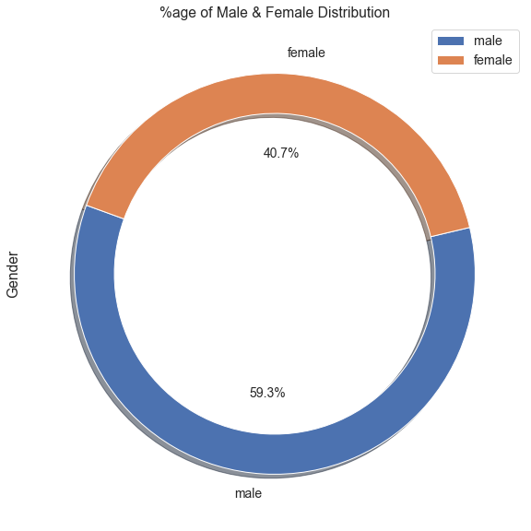
Data Visualization – %age Distribution

Slide 11
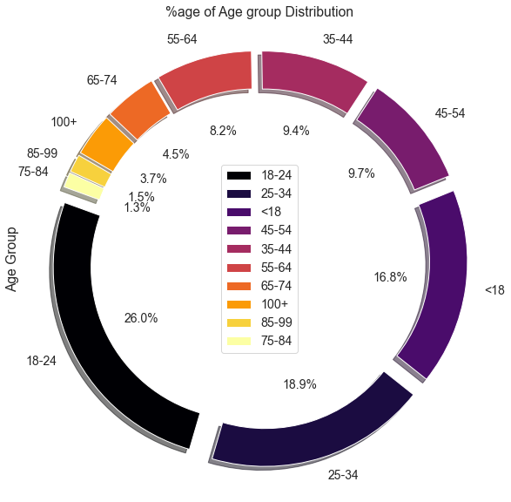
Data Visualization – %age Distribution

Slide 12
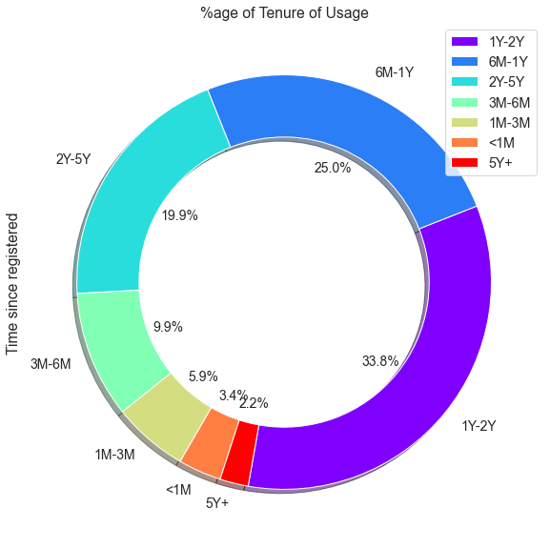
Data Visualization – %age Distribution

Slide 13
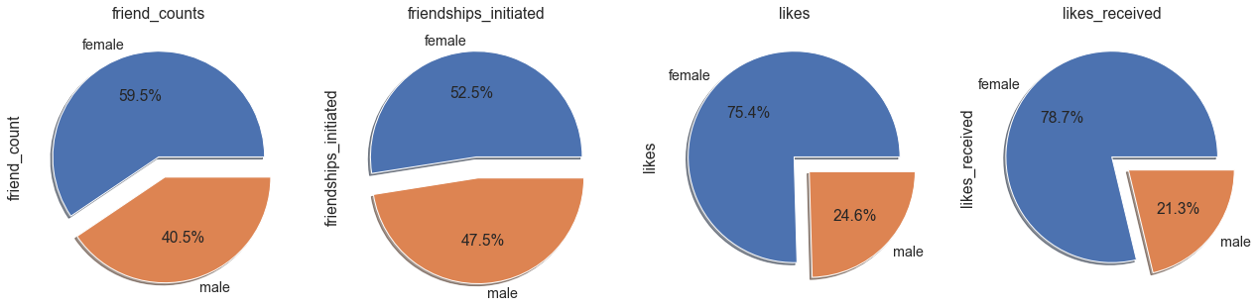
Data Visualization on Activity

Slide 14
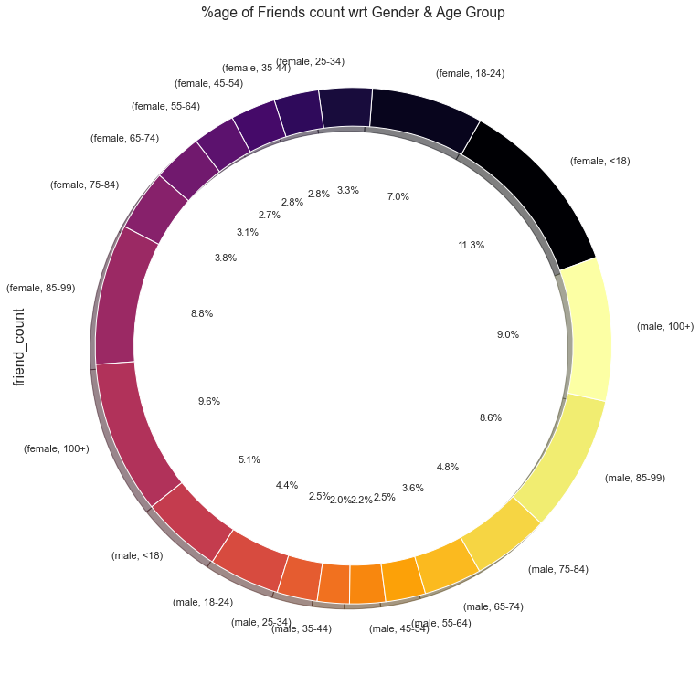
Data Visualization on Activity

Slide 15
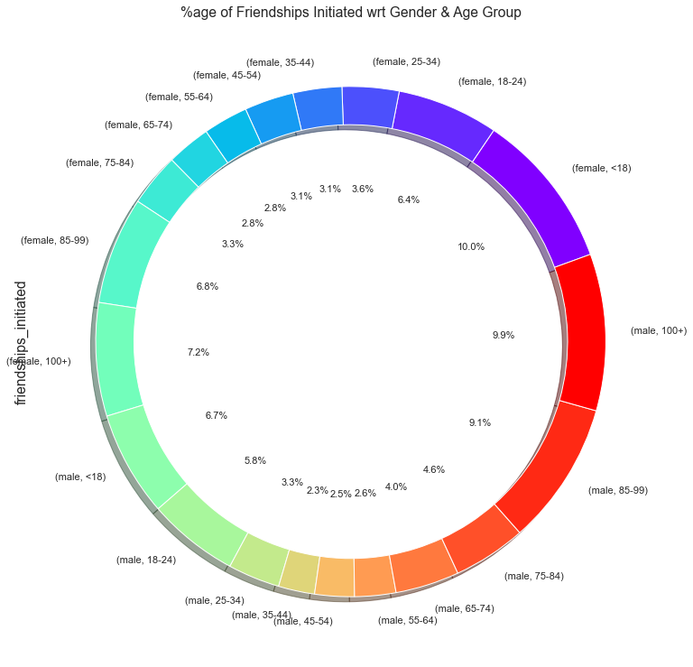
Data Visualization on Activity

Slide 16
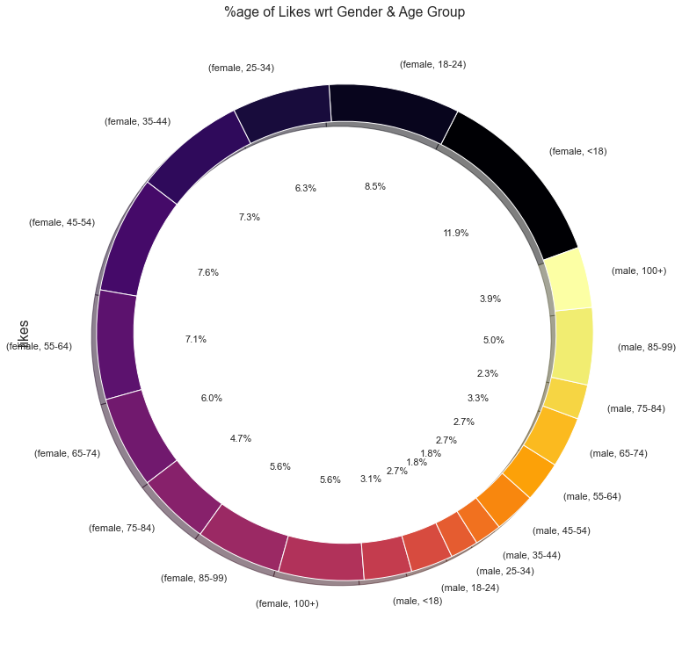
Data Visualization on Activity

Slide 17
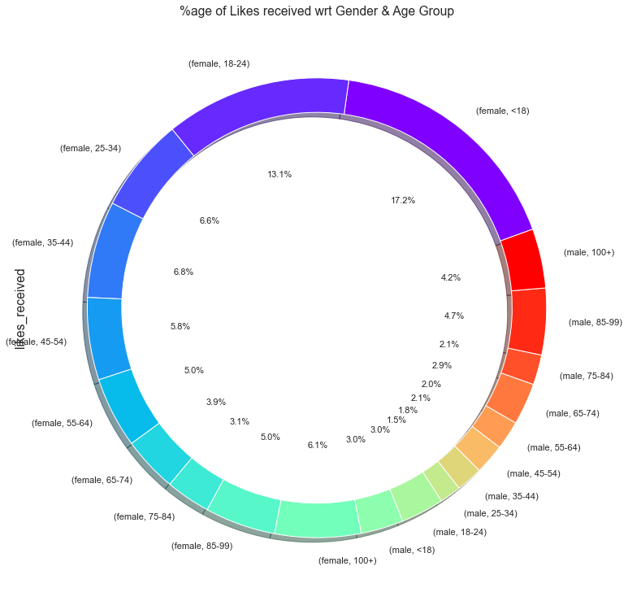
Data Visualization on Activity

Slide 18
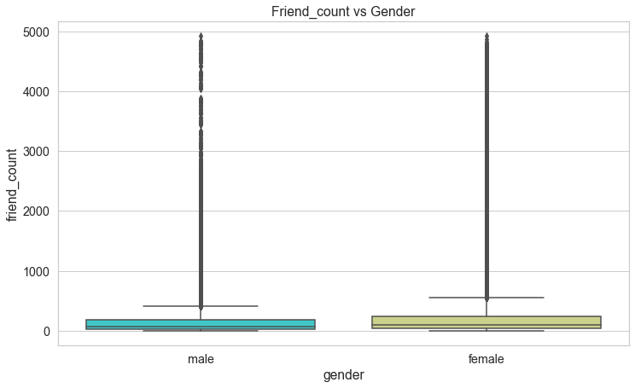
Data Visualization using Box plots

Slide 19
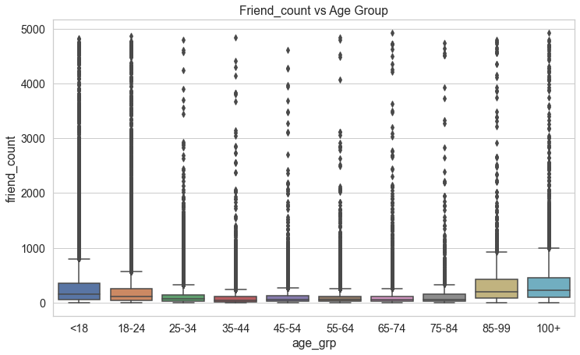
Data Visualization using Box plots

Slide 20
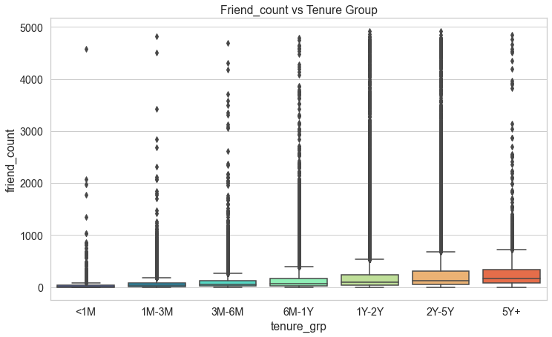
Data Visualization using Box plots

Slide 21
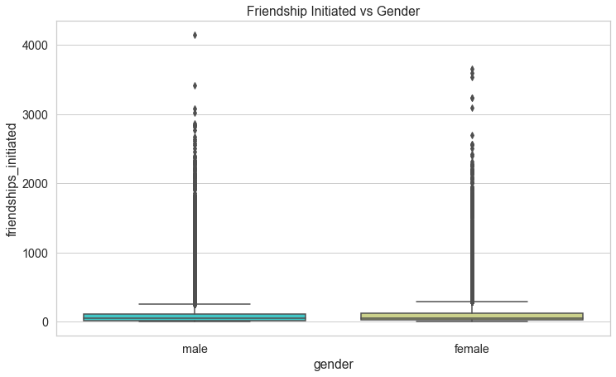
Data Visualization using Box plots

Slide 22
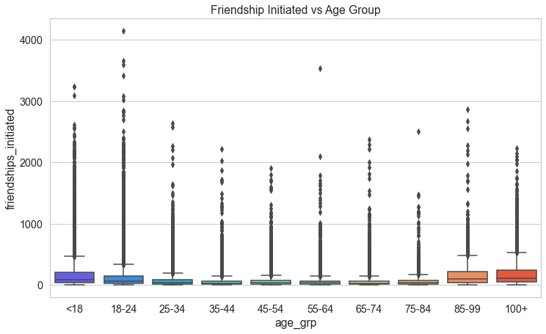
Data Visualization using Box plots

Slide 23
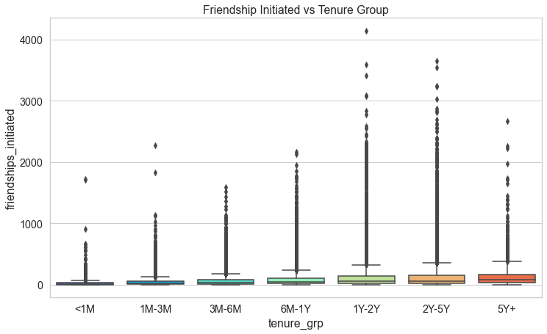
Data Visualization using Box plots

Slide 24
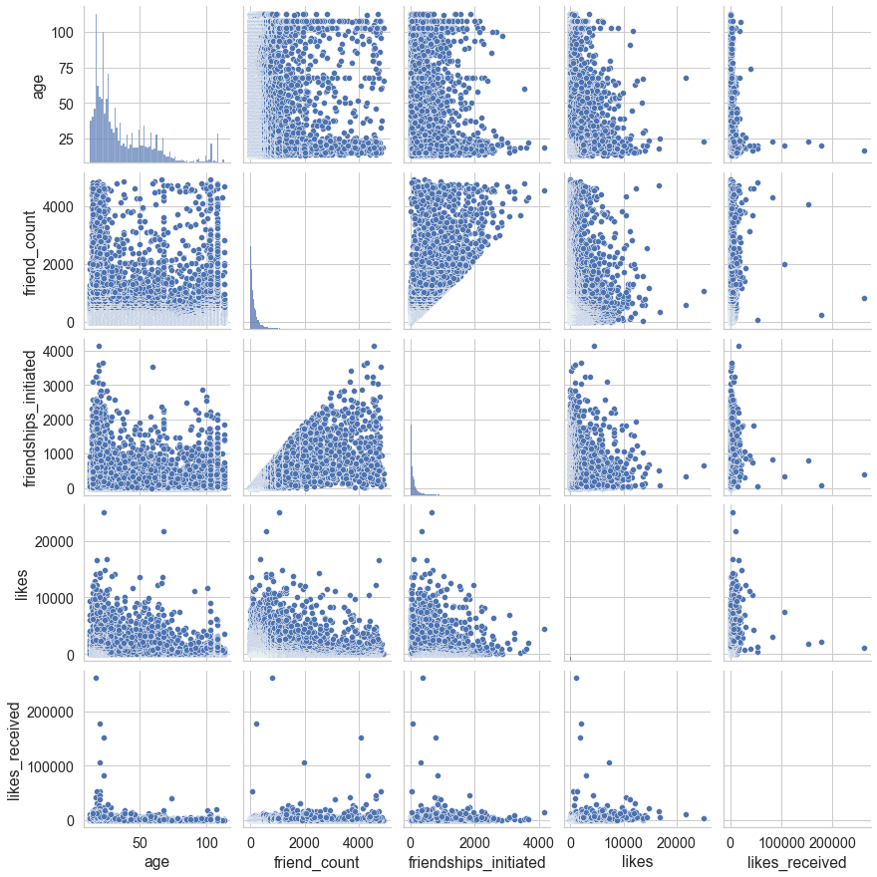
Data Visualization using pairplot

Slide 25
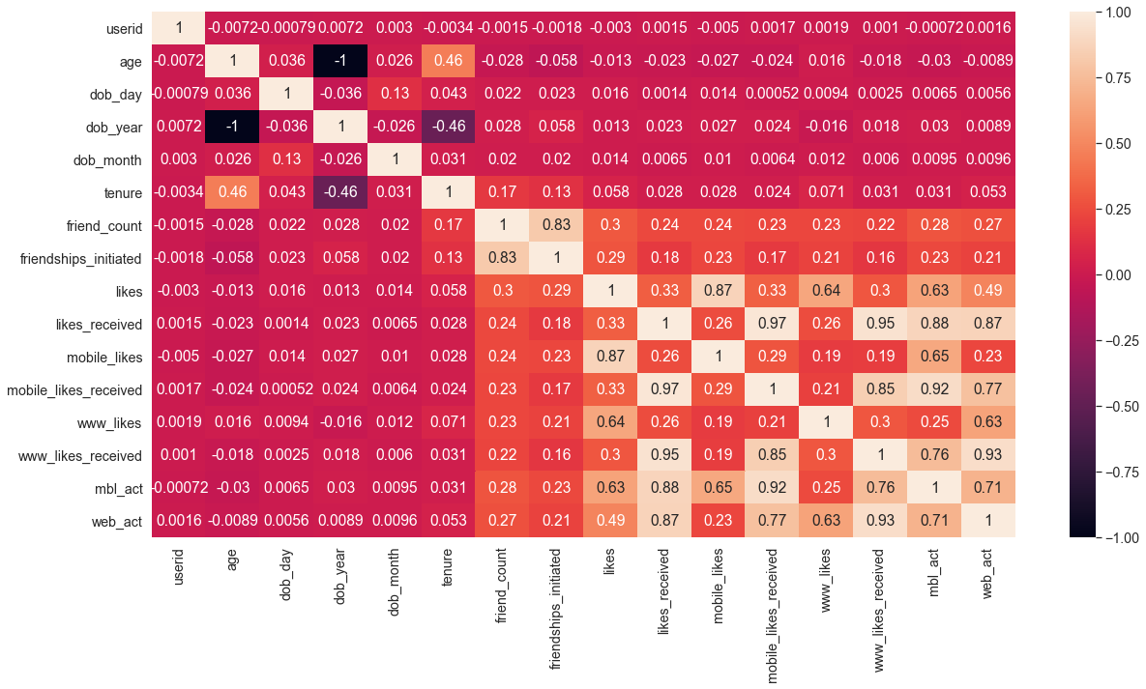
Data Visualization using Heatmap

Slide 26
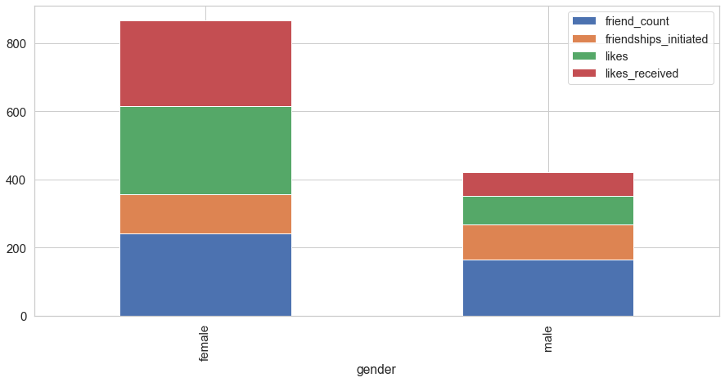
Data Visualization using Stacked Plot

Slide 27
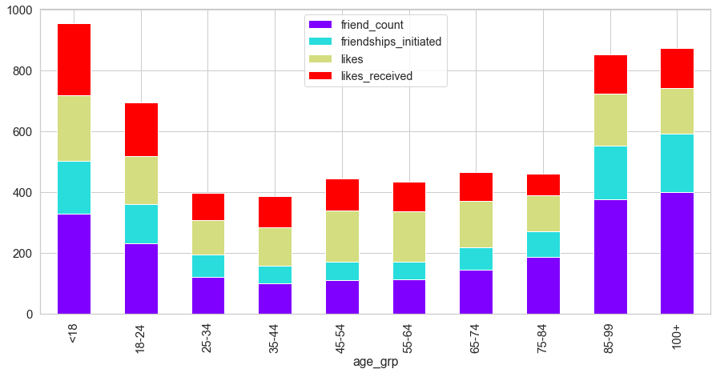
Data Visualization using Stacked Plot

Slide 28
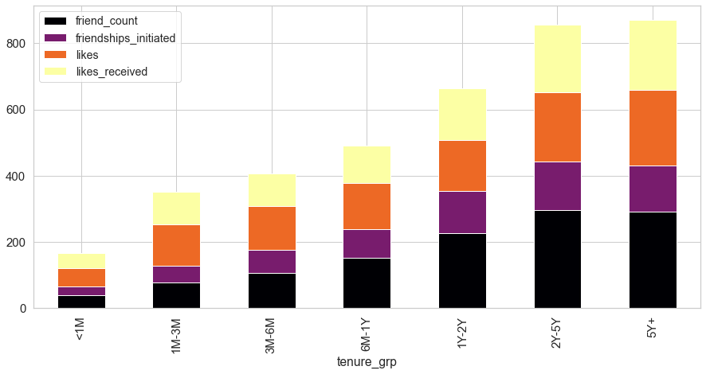
Data Visualization using Stacked Plot

Slide 29
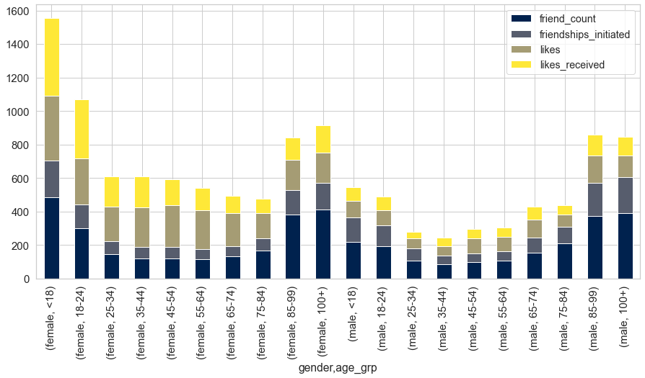
Data Visualization using Stacked Plot

Slide 30
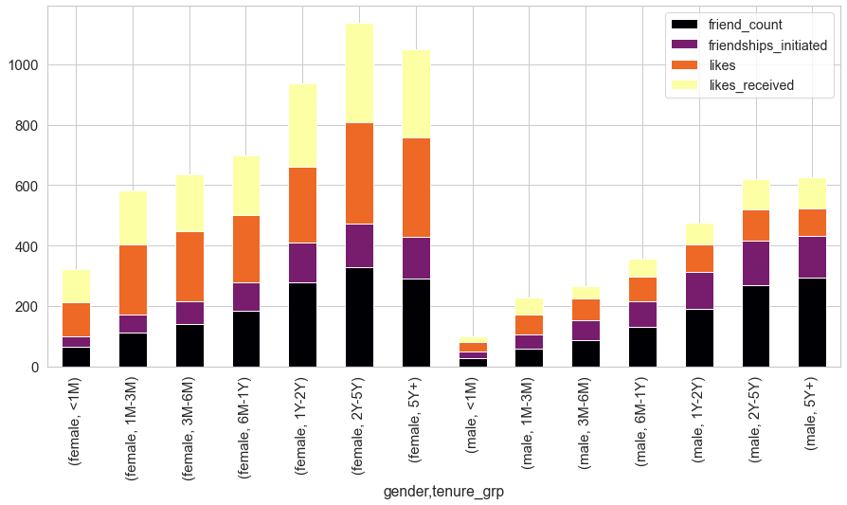
Data Visualization using Stacked Plot

Slide 31
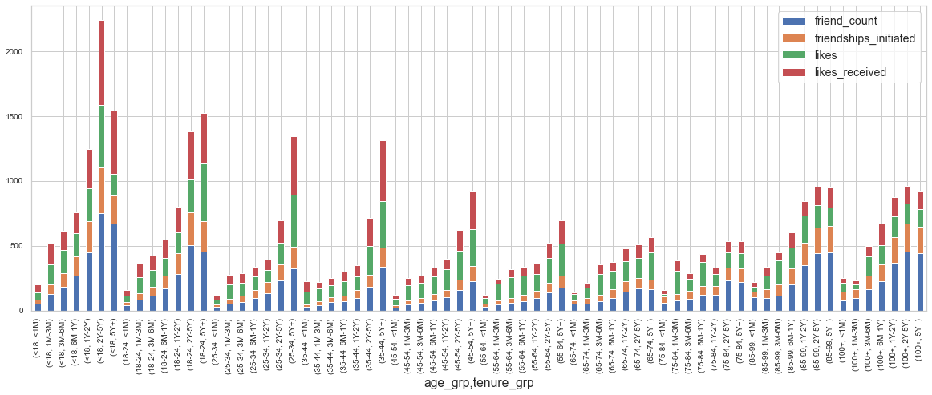
Data Visualization using Stacked Plot

Slide 32
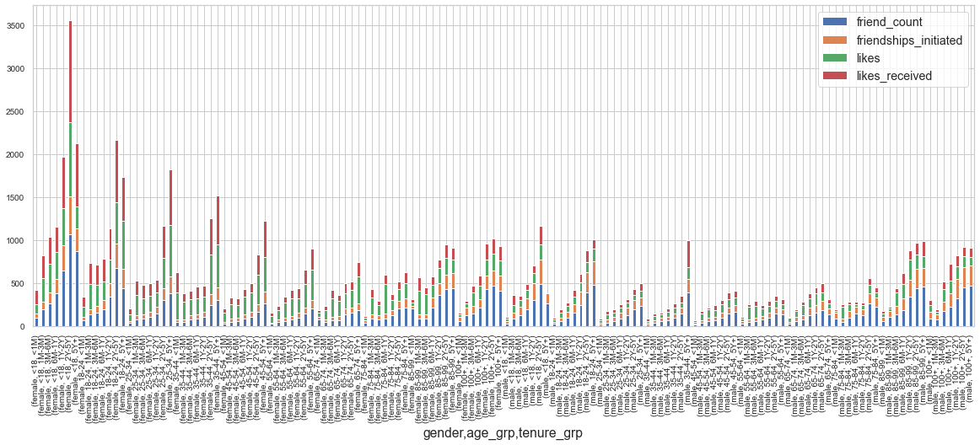
Data Visualization using Stacked Plot

Slide 33
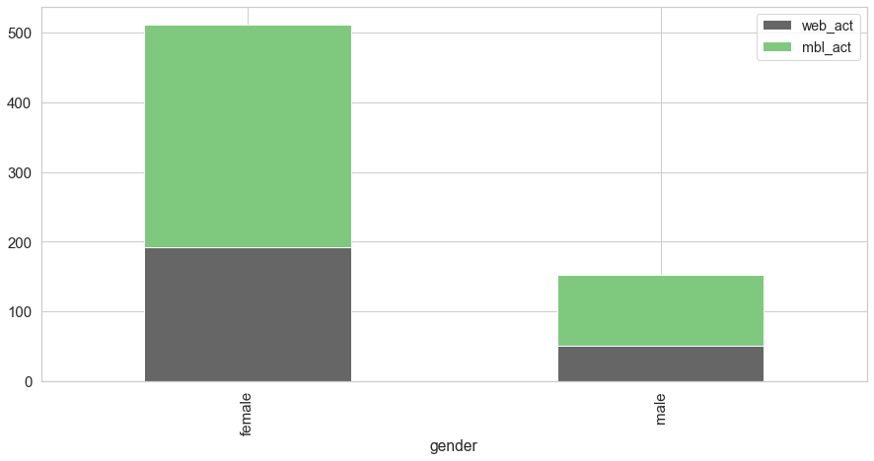
Data Visualization - Medium of Activity

Slide 34
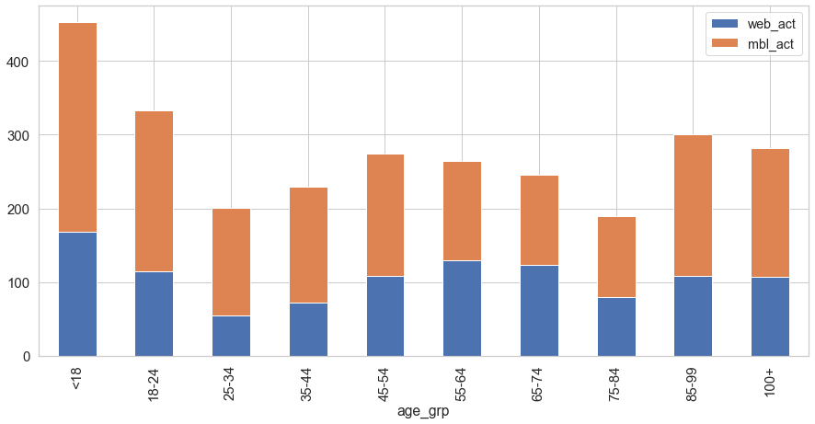
Data Visualization - Medium of Activity

Slide 35
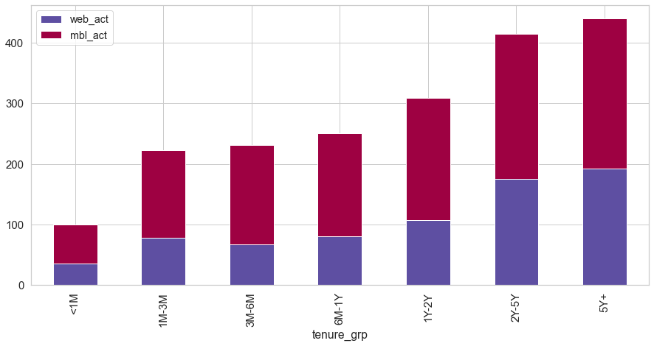
Data Visualization - Medium of Activity

Slide 36
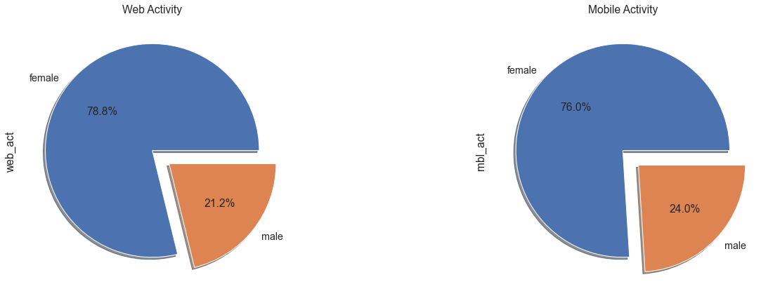
Data Visualization - Medium of Activity

Slide 37
Insights from Data
There are more numbers of male users then female users. But majority of users have very low activity.
The maximum user base is that between the tenure range of 1 years to 2 Years.
The maximum user base is that between the age group of 18 years to 24 Years.
Majority of the social media activity namely 'friend_count','friendships_initiated','likes', 'likes_received' is being done by 10% of the users.

Slide 38
Insights from Data Cont.
Female users are significantly more active then male users. Specially those less then age 24 Years.
There are many users above age 85 who are very active and have good amount of friend counts and activity.
We can clearly see that irrespective of Gender, Age Group or Tenure group, mobile activity is significantly higher then the web activity. So we can conclude that mobile app users are more then the website users.

Slide 39
Actionable Insights
Some incentive based user campaign needs to be launched for age and Gender specific groups, so that the activity of dormant and low activity users can be increased. Resulting in more advertisement revenues.
Facebook mobile app needs to be constantly upgraded and have to be at par with current trends as maximum number of users are using the app for their activity.
New Facebook games/application/advertising should be created for the most active user group i.e. young adults < 24 and also for old users > 75. As both the users have more free time compared to other age group users. Increased activity by these 2 user group will result in more advertisement revenues generated for Facebook.

Slide 40
Thank you

